Slide 1
CS 106A, Lecture 18 Practice with 1D and 2D Arrays

Slide 2




HW5:
ImageShop
We are here
Practice
2D Arrays
Arrays
Midterm!
The River of Java

Slide 3
Plan for Today
Recap: 2D Arrays and Images
Practice: Shrink
Practice: Histogram
Practice: Tic-Tac-Toe

Slide 4
Plan for Today
Recap: 2D Arrays and Images
Practice: Shrink
Practice: Histogram
Practice: Tic-Tac-Toe

Slide 5

The Matrix
Image used under “fair use” for educational purposes.
Source: https://www.themarysue.com/decoding-the-transgender-matrix-the-matrix-as-a-transgender-coming-out-story/

Slide 6
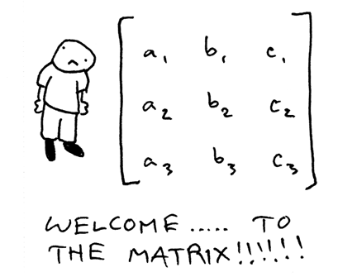
2D Arrays (“Matrices”)

Slide 7
2D Arrays
type[][] name = new type[rows][columns];
int[][] a = new int[3][5];
 | 0 | 1 | 2 | 3 | 4
0 | a[0][0] | a[0][1] | a[0][2] | a[0][3] | a[0][4]
1 | a[1][0] | a[1][1] | a[1][2] | a[1][3] | a[1][4]
2 | a[2][0] | a[2][1] | a[2][2] | a[2][3] | a[2][4]

Slide 8
2D Arrays = Arrays of Arrays!
int[][] a = new int[3][4];
int[] firstRow = a[0];
a[0][0] | a[0][1] | a[0][2] | a[0][3]
a[1][0] | a[1][1] | a[1][2] | a[1][3]
a[2][0] | a[2][1] | a[2][2] | a[2][3]

Slide 9
Summary: 2D Arrays
Make a new 2D array
type[][] name = new type[rows][columns];
Get and set values using bracket notation
name[row][col] // get elem at row,col
name[row][col] = value; // set elem at row,col
Get the number of rows and columns
arr.length // # rows
arr[0].length // # columns
Iterate over a 2D array using a double for-loop
for (int row = 0; row < arr.length; row++) {
for (int col = 0; col < arr[0].length; col++) {
// do something with arr[row][col];
}
}

Slide 10
Limitations of 2D Arrays
Unlike 1D arrays, you cannot compare 2D arrays with Arrays.equals. You must use Arrays.deepEquals.
int[][] a1 = ...
int[][] a2 = ...
if (Arrays.deepEquals(a1, a2)) { ... }
A 2D array does not know how to print itself:
int[][] a = new int[rows][cols];
println(a); // [[I@8cf420
println(Arrays.toString(a)); // [[I@6b3f44,[I@32c2a8]...
// [[0, 1, 2, 3, 4], [1, 2, ...
println(Arrays.deepToString(a));
Notes:
Just like how we can’t do much with chars – but luckily, there are Character methods! Same thing for Arrays.

Slide 11

Images
Images are just grids (2D arrays!) of pixels! Pixels are just integer values from 0-255.

Slide 12
Images as 2D Arrays
We can get a GImage as a 2D array of pixels.
GImage img = new GImage(“res/daisy.jpg”);
int[][] pixels = img.getPixelArray();
int pixel = pixels[0][0]; // top-left pixel
Notes:
How do you modify the pixels?

Slide 13
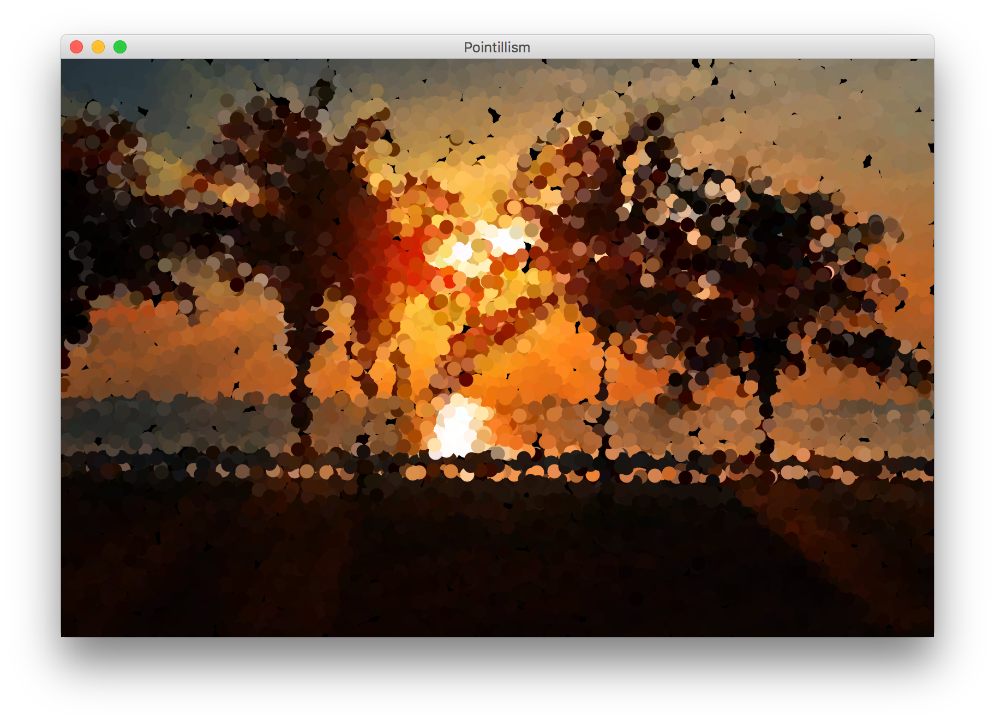

Example: Pointillism
Pointillism is an art style where many small dots of color are combined to make a larger image.

Slide 14
Red, Green and Blue in one int?
Images encode the R, G, and B values of a pixel into a single integer between 0 and 255. You can convert between this pixel value and the individual RGB values.
int[][] pixels = image.getPixelArray();
int px = pixels[0][0];
int red = GImage.getRed(px);
int green = GImage.getGreen(px);
int blue = GImage.getBlue(px);

Slide 15
Creating New Pixels
Images encode the R, G, and B values of a pixel into a single integer between 0 and 255. You can convert between this pixel value and the individual RGB values.
You can also create pixels with your own RGB values.
int r = ...
int g = ...
int b = ...
int pixel = GImage.createRGBPixel(r, g, b);

Slide 16
Images as 2D Arrays
We can get a GImage as a 2D array of pixels, and modify it any way we want. Then, we can create a new GImage with the modified pixels.
GImage img = new GImage(“res/daisy.jpg”);
int[][] pixels = img.getPixelArray();
... (modify pixels)
img.setPixelArray(pixels); // update image
// or make a new GImage
GImage newImg = new GImage(pixels);

Slide 17
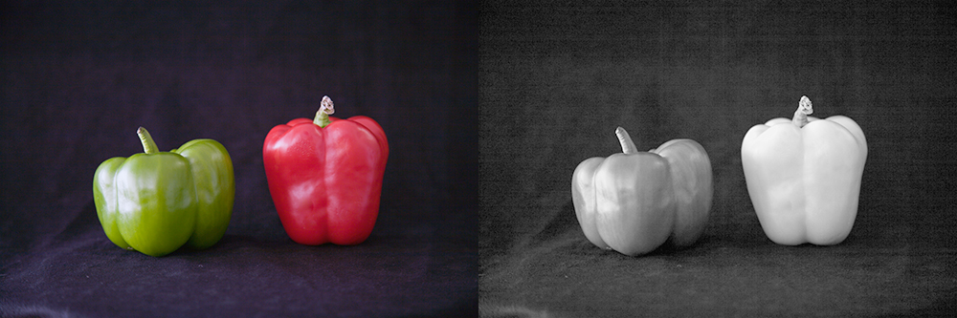
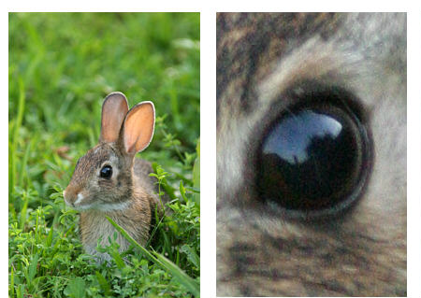
Modifying Image Pixels
There are many cool image algorithms based around modifying individual pixels in an image: grayscale, brighten, normalize, remove red-eye…
grayscale
zoom

Slide 18
GImage Pixel Methods
GImage img = new GImage("res/daisy.jpg");
Method name | Description
img.getPixelArray() | returns pixels as 2D array of ints, where each int in the array contains all 3 of Red, Green, and Blue merged into a single integer
img.setPixelArray(array); | updates pixels using the given 2D array of ints
GImage.createRGBPixel(r, g, b) | returns an int that merges the given amounts of red, green and blue (each 0-255)
GImage.getRed(px) GImage.getGreen(px) GImage.getBlue(px) | returns the redness, greenness, or blueness of the given pixel as an integer from 0-255

Slide 19
Recap: Modifying Pixels
Extract pixel RGB colors with GImage.getRed/Blue/Green.
int red = GImage.getRed(pixels[0][0]); // 0-255
int green = GImage.getGreen(pixels[0][0]); // 0-255
int blue = GImage.getBlue(pixels[0][0]); // 0-255
Modify the color components for a given pixel.
red = 0; // remove redness
Combine the RGB back together into a single int.
pixels[0][0] = GImage.createRGBPixel(red, green, blue);
Update the image with your modified pixels when finished.
image.setPixelArray(pixels);

Slide 20
Plan for Today
Recap: 2D Arrays and Images
Practice: Shrink
Practice: Histogram
Practice: Tic-Tac-Toe

Slide 21
Shrink
Let’s write a program that can shrink an image to ½ its original size.

Slide 22
Shrink

Slide 23
Shrink

Slide 24
Shrink
Given a pixel (x, y) in our smaller image, how do we know which pixel in our larger image should go there?

Slide 25
Shrink
Given a pixel (x, y) in our smaller image, how do we know which pixel in our larger image should go there?
(0 , 0) |  | (0, 2)
(2, 0) |  | (2, 2)
(0, 0) | (0, 1)
(1, 0) | (1, 1)

Slide 26
Shrink
Given a pixel (x, y) in our smaller image, how do we know which pixel in our larger image should go there?

Slide 27
Shrink
int[][] pixels = image.getPixelArray();
int[][] result =
new int[pixels.length/2][pixels[0].length/2];
for (int r = 0; r < result.length; r++) {
for (int c = 0; c < result[0].length; c++) { result[r][c] = pixels[r*2][c*2];
}
}
image.setPixelArray(result);

Slide 28
Shrink
int[][] pixels = image.getPixelArray();
int[][] result =
new int[pixels.length/2][pixels[0].length/2];
for (int r = 0; r < result.length; r++) {
for (int c = 0; c < result[0].length; c++) { result[r][c] = pixels[r*2][c*2];
}
}
image.setPixelArray(result);

Slide 29
Shrink
int[][] pixels = image.getPixelArray();
int[][] result =
new int[pixels.length/2][pixels[0].length/2];
for (int r = 0; r < result.length; r++) {
for (int c = 0; c < result[0].length; c++) { result[r][c] = pixels[r*2][c*2];
}
}
image.setPixelArray(result);

Slide 30
Shrink
int[][] pixels = image.getPixelArray();
int[][] result =
new int[pixels.length/2][pixels[0].length/2];
for (int r = 0; r < result.length; r++) {
for (int c = 0; c < result[0].length; c++) { result[r][c] = pixels[r*2][c*2];
}
}
image.setPixelArray(result);

Slide 31
Shrink
int[][] pixels = image.getPixelArray();
int[][] result =
new int[pixels.length/2][pixels[0].length/2];
for (int r = 0; r < result.length; r++) {
for (int c = 0; c < result[0].length; c++) { result[r][c] = pixels[r*2][c*2];
}
}
image.setPixelArray(result);

Slide 32
Shrink
int[][] pixels = image.getPixelArray();
int[][] result =
new int[pixels.length/2][pixels[0].length/2];
for (int r = 0; r < result.length; r++) {
for (int c = 0; c < result[0].length; c++) { result[r][c] = pixels[r*2][c*2];
}
}
image.setPixelArray(result);

Slide 33
Plan for Today
Recap: 2D Arrays and Images
Practice: Shrink
Practice: Histogram
Practice: Tic-Tac-Toe

Slide 34
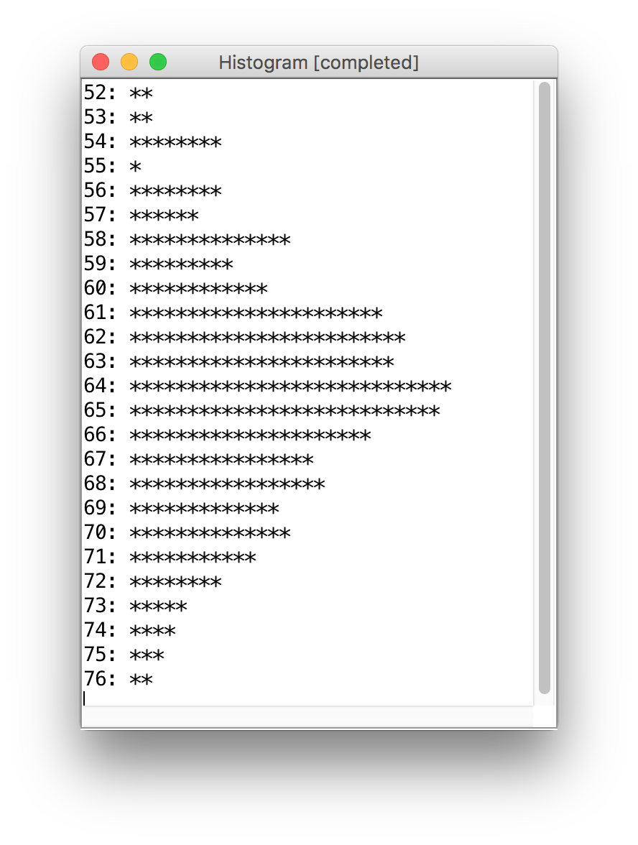
Weather Histogram
Given a file of temperatures (int), such as:
82
66
79
63
83
Write a Histogram program that will print a histogram of stars indicating the # of days with each unique temperature.
85: *****
86: ************
87: ***
88: *
Notes:
How does an array help us?

Slide 35
Idea: Array of Counters
For problems like this, where we want to keep count of many things, a frequency table (or tally array) can be a clever solution.
Idea: The element at index i will store a counter for the digit value i.
example: count of temperatures:
index | … | 55 | 56 | 57 | 58 | 59 | 60 | 61 | 62 | …
value |  | 1 | 0 | 4 | 1 | 0 | 0 | 1 | 1

Slide 36
Plan for Today
Recap: 2D Arrays and Images
Practice: Shrink
Practice: Histogram
Practice: Tic-Tac-Toe

Slide 37
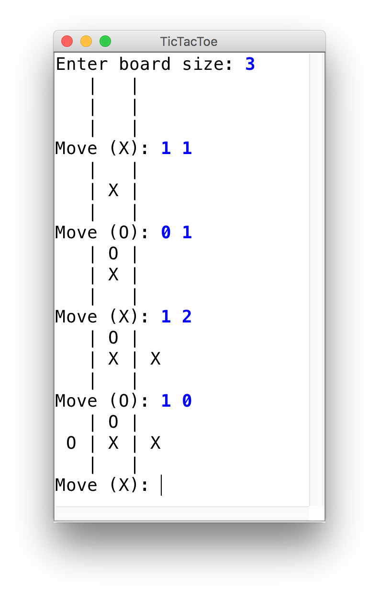
Tic-Tac-Toe
Let’s use 2D arrays to create a ConsoleProgram version of Tic-Tac-Toe.

Slide 38
Recap
Recap: 2D Arrays and Images
Practice: Shrink
Practice: Histogram
Practice: Tic-Tac-Toe
Next Time: More data structures

